Slide 1
Cross-Enterprise Certified Datasets
Data Architecture COP
2020-03-24

Slide 2
Certified Dataset Definition
A certified data set (CDS) is defined as data that has been subjected to a structured quality process and certified by a data owner to ensure it meets standards set by its intended consumers.
Certified data sets are intended to help gain consistency, build confidence and trust, increase the value of Cargill data, and improve the accessibility and visibility of data.
Notes:
Current definition from wiki page: https://wiki.cglcloud.com/index.php/Certified_Data_Sets

Slide 3
Cross Enterprise Certified Dataset Definition
A Cross Enterprise certified data set (xCDS) is defined as a certified dataset¹ that is reviewed by the Data Architecture Community of Practice (DA COP) to assure it meets standards set by the Data Guild for use across all of Cargill.
Cross Enterprise certified data sets are intended to be shared with anyone at Cargill with a need for that data. Different physical datasets may be required to support different needs; e.g., operational uses may require a different dataset than analytical uses.
The Cross Enterprise certification process is intended to provide complete confidence that the dataset will provide accurate, consistent, complete, and timely access to the data for as many use cases and consumers as possible.
Notes:
1 – see definition of certified dataset on previous slide

Slide 4
Alternatives for “Cross Enterprise”
Cross Cargill
Cargill-wide
Global (Globally)
Universal (Universally)
One Cargill

Slide 5
Data Architecture Community of Practice
The Data Architecture Community of Practice (DA COP) assures the dataset meets specified criteria, it is not charged with fulfilling the criteria nor resolving dataset issues.
Not all datasets will be reviewed by the DA COP, only datasets that meet the criteria of Cross Enterprise.

Slide 6
Dataset Value Chain
Product Owner 1
Product Owner 2
Product Owner 3
SAP
CDP
SQL
Even though the certification is for a specific physical dataset, we must ensure the data is well managed throughout its value chain.
Data Owner A
GL
GL
GL
Data Owner B
AP
AP
AP
Data Owner C
AR
AR
AR
Data Owner D
CC
CC
CC
Notes:
Key Points:
Data Owner is different than product owner
Not just CDP
Need understanding of value chain, but the degree of documentation is TBD

Slide 7
Dataset Sharing
Certification is intended to ensure the dataset is suitable for multiple purposes and consumers
SAP
CDP
SQL
GL
GL
GL
AP
AP
AP
AR
AR
AR
Share 1
CC
CC
CC
Share 2
Notes:
Must be shared with 2 or more other business units to be considered cross-enterprise

Slide 8
Original Checklist Summary
 |  | Checklist
Ownership | 1 | Data owner identified and performing the accountabilities as defined
 | 2 | CDS reviewed and aligned with stakeholders
Alignment | 3 | Original data source(s) defined
 | 4 | Refresh frequency defined
 | 5 | End to end documentation in place
 | 6 | Usage purpose identified
Data Quality | 7 | Expectation and targets established
 | 8 | Regular monitoring and measurement established
 | 9 | Data Steward role established
Accessibility | 10 | Intake process established for data requests and access
Visibility | 11 | Data catalog / dictionary available for users
Data Security | 12 | Data is appropriately secured
 | 13 | Legal and compliance checks completed
 | 14 | Retention policy appropriately implemented
Metadata | 15 | Minimum metadata elements captured
 | 16 | Business rules and definitions documented
Development | 17 | Development and architecture standards followed

Slide 9
Checklist Summary
 |  | Checklist
Ownership | 1 | Data owner is defined and performing accountabilities
 | 2 | Aligned with stakeholders expectations
Alignment | 3 | Data sources are documented
 | 4 | Latency is documented
 | 5 | Architecture is documented
 | 6 | Use cases are documented
Data Quality | 7 | Data quality expectations are defined
 | 8 | Data quality monitoring and remediation established
 | 9 | Data Stewards identified and performing responsibilities
Accessibility | 10 | Process established for obtaining access
 | 11 | Communication plans in place
Visibility | 12 | Documentation is assessible
Compliance | 13 | Appropriately secured
 | 14 | Compliant with legal and regulatory requirements
 | 15 | Lifecycle is documented and implemented
Metadata | 16 | Metadata is captured and available
 | 17 | Business rules defined and followed
 | 18 | Linked to Cargill’s Data Taxonomy
Development | 19 | Complies with architecture and development standards
Deployment | 20 | Potential value of the dataset is documented
 | 21 | Deployment Plan is defined
 | 22 | Marketing Plan is in place
 | 23 | Service Level Agreement is documented

Slide 10
Checklist - Ownership
# | Checklist Item | Description
1 | Data owner is defined and performing accountabilities | A person has been named as data owner for the data concept, their contact information is documented, and they are aware of and performing all accountabilities as defined by the Data Guild.
2 | Aligned with stakeholders expectations | The dataset has been reviewed with the stakeholders across the organization, not just project stakeholders.

Slide 11
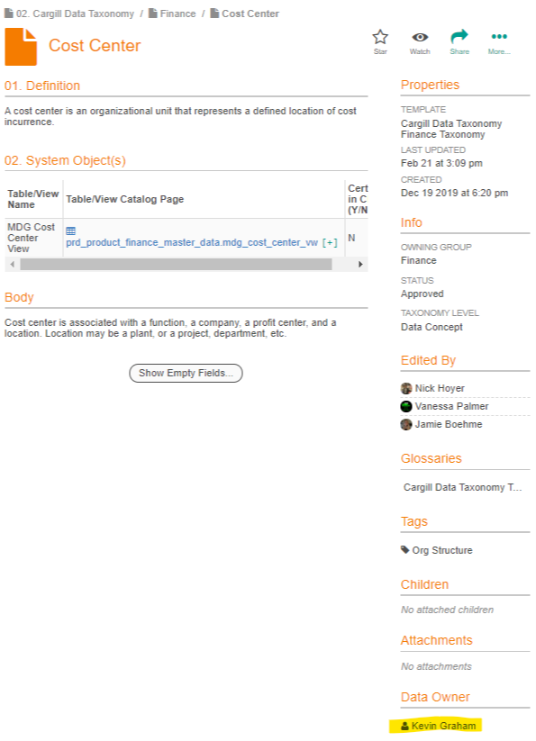
Checklist – Ownership - 1 – Data Owner
A person has been named as data owner for the data concept, their contact information is documented
Dataset linked to Data Concept – Data Concept has Data Owner defined
and they are aware of and performing all accountabilities as defined by the Data Guild
The accountabilities for a Data Owner are defined on the Data Ownership wiki page.
Notes:
The second part can only be verified by the Data Lead/Data Architect involved.
It may not be possible to fulfill all 13 accountabilities. Is there a subset that is required?
https://wiki.cglcloud.com/index.php/Data_Ownership

Slide 12
Checklist – Ownership - 2 – Stakeholder Alignment
The dataset has been reviewed with the stakeholders across the organization, not just project stakeholders
Product/Project Stakeholders
Data Production Stakeholders (upstream)
Data Consumer Stakeholders (downstream)
Need not be 100% coverage of stakeholders but enough to ensure proper definition and requirements
Need not be 100% agreement on requirements but enough to ensure maximum reuse across enterprises
Notes:
Can only be verified by the Data Architect/Data Lead involved.
Is there a minimum required?

Slide 13
Checklist – Alignment
# | Checklist Item | Description
3 | Data sources are documented | The full lineage of data sources are documented from original capture through all transitional stages to the final dataset, including database and table names.
4 | Latency is documented | The expected latency and refresh frequency of the dataset is documented including source systems, explaining any differences from original data sources.
5 | Architecture is documented | The architecture of how the dataset is constructed is documented including process flow diagrams, transformations, joins, data elements, access points, traceability and auditability.
6 | Use cases are documented | The intended use cases for how the dataset is intended to be used (e.g., application, analytics, reporting) is documented

Slide 14
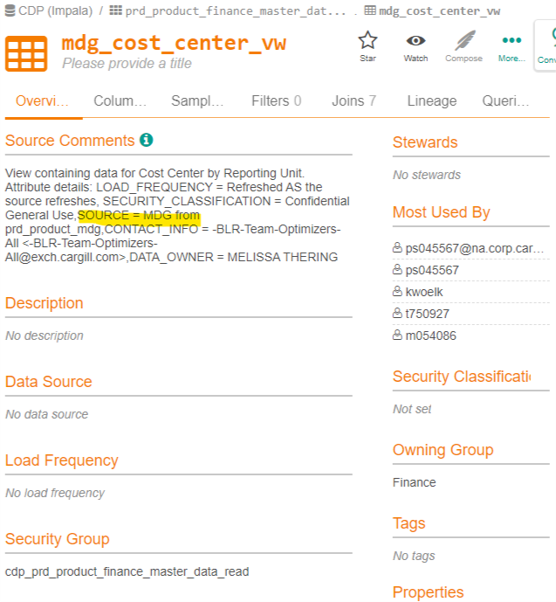
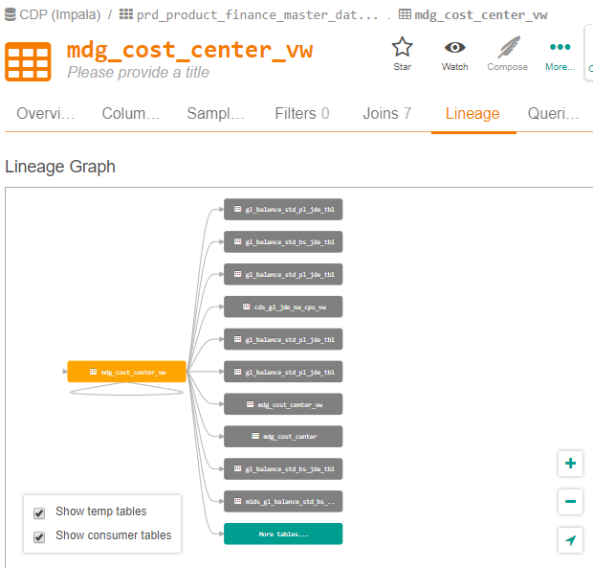
Checklist – Alignment - 3 – Data Sources
The full lineage of data sources are documented from original capture through all transitional stages to the final dataset, including database and table names
Must capture the full value chain from capture, not just the immediate source of the dataset
Need not include 100% of sources, but limitations should be documented (#7) and accounted for in use cases (#6)
Notes:
If use case is not possible with limited sources then it should not be included as a use case until suficcient sources are included.

Slide 15
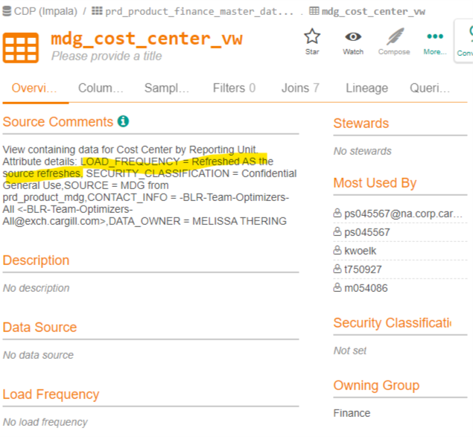
Checklist – Alignment - 4 – Data Latency
The expected latency and refresh frequency of the dataset is documented including source systems, explaining any differences from original data sources
Again, must capture the full value chain from capture, not just the immediate source of the dataset
If parts of the dataset come from different sources, must identify the frequency of each part
Notes:
Latency/refresh frequency of the CDS must be the lowest common denominator of all sources.

Slide 16
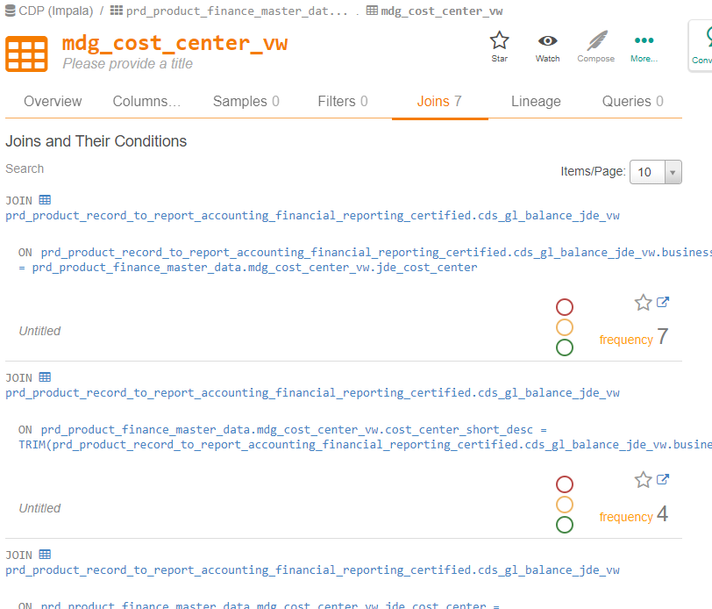
Checklist – Alignment - 5 – Architecture
The architecture of how the dataset is constructed is documented including process flow diagrams, transformations, joins, access points, data elements, traceability and auditability
Notes:
Does Process Flow = Data Flow Diagrams?
Are data models required?
The architecture documentation should include purging processes (#15)

Slide 17
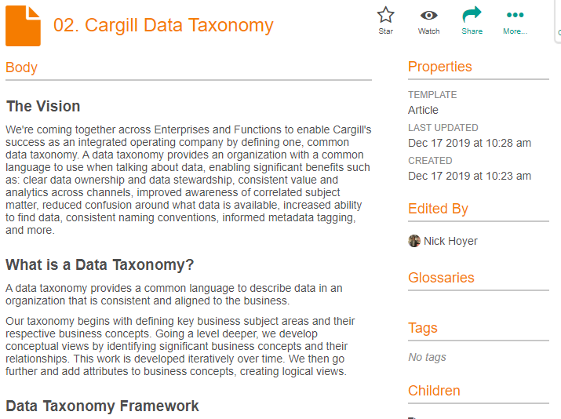

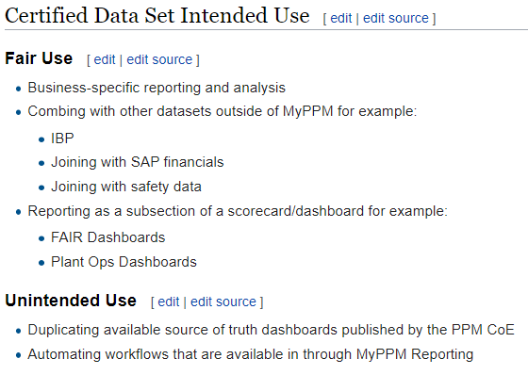
Checklist – Alignment - 6 – Use Cases
The intended use cases for how the dataset is intended to be used (e.g., application, analytics, reporting) is documented
There may be different access points for different use cases
Anticipated roles for data consumers should be documented
May also include use cases for which the dataset is NOT intended to support
Notes:
Different “levels of certification” may involve different use cases, not yet available – which should not be included
Data sources and data quality should fully support all expresses use cases.

Slide 18
Multiple Certified Datasets
A single data concept could have multiple certified datasets for different use cases
SAP
CDP
SQL
GL
GL
GL
AP
AP
AP
AR
AR
AR
CC
CC
CC
Analytic Use Cases
Operational Use Cases
Notes:
Must be shared with 2 or more other business units to be considered cross-enterprise

Slide 19
Checklist – Data Quality
# | Checklist Item | Description
7 | Data quality expectations are defined | Data quality rules are defined and the results published, including metrics on accuracy, validity, timeliness, completeness, uniqueness, consistency and security.
8 | Data quality monitoring and remediation established | Data quality monitoring is developed and verified and resources and processes are in place to remediate any data quality issues identified.
9 | Data Stewards identified and performing responsibilities | People have been named as data stewards for the dataset, their contact information is documented, and they are aware of and performing all responsibilities.

Slide 20
Checklist – Data Quality - 7 – Data Quality
Data quality rules are defined and the results published, including metrics on accuracy, validity, timeliness, completeness, uniqueness, consistency and security.
Define data quality rules in InfoSteward
Contact the Data Quality team through the Data Quality Homepage
Data quality rules should encompass the entire value chain of the dataset; that is end-to-end quality checks
Data quality rules should include both business and technology checks
Notes:
Do all data quality checks need to be in InfoSteward?
Data quality rules need to be understood across the entire value chain. Do they all need to be in InfoSteward and documented the same?
http://ithub.cargill.com/serviceoperations/DQ/Pages/Welcome-to-Data-Quality-Home-Page.aspx

Slide 21
Checklist – Data Quality - 8 – Data Quality Monitoring
Data quality monitoring is developed and verified
Monitoring is in place and results are published in DCP
and resources and processes are in place to remediate any data quality issues identified
Data quality issues will not affect certification unless issue are persistent and use cases for data consumption
Notes:
Remediation processes can only be verified by the Data Architect/Data Lead involved.
Remediation processes need not correct data in source (but that is preferred)
Critical issues should be communicated to data consumers (#11)

Slide 22
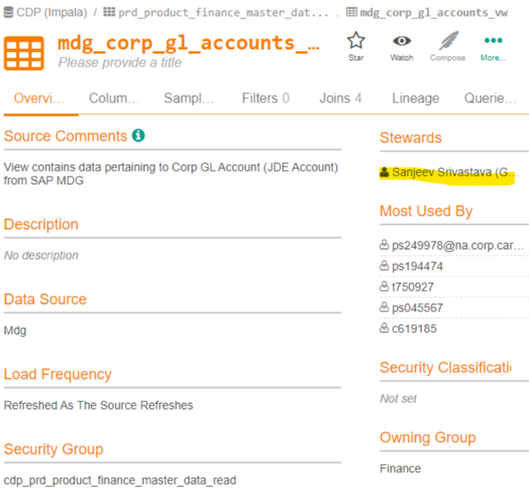
Checklist – Data Quality - 9 – Data Stewards
People have been named as data stewards for the dataset, their contact information is documented
Steward information should be documented in DCP
and they are aware of and performing all responsibilities.
The responsibilities for a Data Steward are defined on the Data Stewardship wiki page
Notes:
The second part can only be verified by the Data Lead/Data Architect involved.
It may not be possible to fulfill all 11 accountabilities. Is there a subset that is required?
Data stewards need only be identified for the certified dataset, but lack of stewards along the value chain may affect data quality and reliability
https://wiki.cglcloud.com/index.php/Data_Stewardship

Slide 23
Checklist - Accessibility
# | Checklist Item | Description
10 | Process established for obtaining access | Processes are in place to request, validate, and grant access to the dataset.
11 | Communication plans in place | All data consumers of the dataset are identified and documented and communication plans are in place to notify consumers of any issues with the dataset.

Slide 24
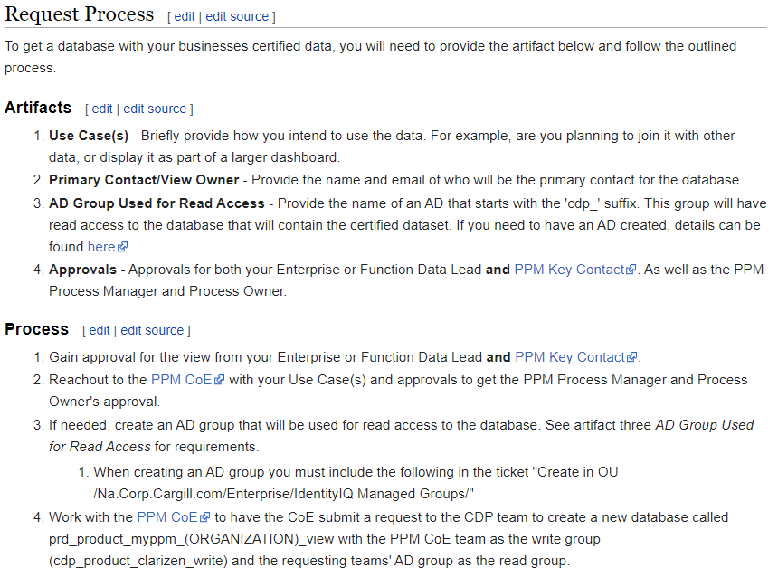
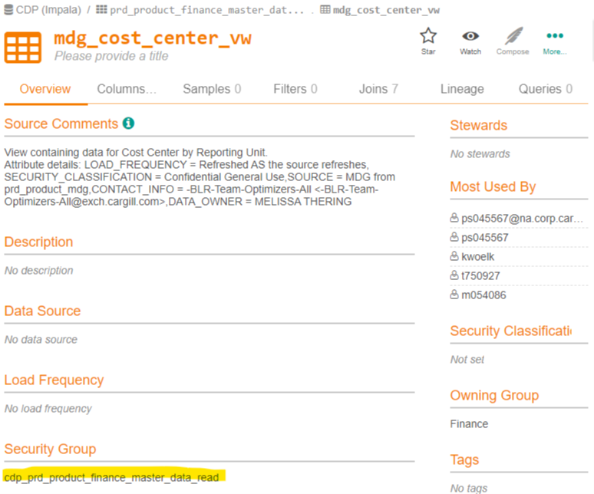
Checklist – Accessibility - 10 – Accessibility
Processes are in place to request, validate, and grant access to the dataset
Active Directory (AD) groups should be defined to allow access to the dataset
Cargill’s access control should be used for data consumers to request access to the dataset
The process for requesting access should be documented in DCP
Notes:
https://access.cargill.com/identityiq/home.jsf

Slide 25
Checklist – Accessibility - 11 – Communication Plan
All data consumers of the dataset are identified and documented
and communication plans are in place to notify consumers of any issues with the dataset
All availability and quality issues should be communicated
Data consumers should be able to subscribe or unsubscribe from communications
Notes:
Is the AD group enough documentation of data consumers?
Communication plans can only be verified by the Data Architect/Data Lead involved.
Is there a common communication framework that should be leveraged?

Slide 26
Checklist - Visibility
# | Checklist Item | Description
12 | Documentation is assessible | All documentation about the dataset (especially relative to the certification checklist) is captured and available in a centralized location for data consumers to locate and access as needed.

Slide 27
Checklist – Visibility - 12- Documentation
 |  | Checklist
Ownership | 1 | Data owner is defined and performing accountabilities
 | 2 | Aligned with stakeholders expectations
Alignment | 3 | Data sources are documented
 | 4 | Latency is documented
 | 5 | Architecture is documented
 | 6 | Use cases are documented
Data Quality | 7 | Data quality expectations are defined
 | 8 | Data quality monitoring and remediation established
 | 9 | Data Stewards identified and performing responsibilities
Accessibility | 10 | Process established for obtaining access
 | 11 | Communication plans in place
Visibility | 12 | Documentation is assessible
Compliance | 13 | Appropriately secured
 | 14 | Compliant with legal and regulatory requirements
 | 15 | Lifecycle is documented and implemented
Metadata | 16 | Metadata is captured and available
 | 17 | Business rules defined and followed
 | 18 | Linked to Cargill’s Data Taxonomy
Development | 19 | Complies with architecture and development standards
All documentation about the dataset (especially relative to the certification checklist)
Not all checklist items can be documented
is captured and available in a centralized location for data consumers to locate and access as needed
All documentation about the dataset should be captured in DCP
Notes:
New Alation templates may be needed for some of this documentation.
Should all checklist items at least have a flag to indicate completion?
https://datacatalog.cglcloud.com/

Slide 28
Checklist – Compliance
# | Checklist Item | Description
13 | Appropriately secured | Security measures are in place that reflect the security classification assigned to the data concept, this includes auditing, access controls, and risk mitigation.
14 | Compliant with legal and regulatory requirements | All measures are in place to ensure the dataset meets all legal and contractual requirements, including privacy, storage and consumption requirements.
15 | Lifecycle is documented and implemented | The entire lifecycle of the data in the dataset must be documented from creation to destruction and must be in alignment with any Records Information Management (RIM) retention policies; and process must be in place to implement those policies.

Slide 29
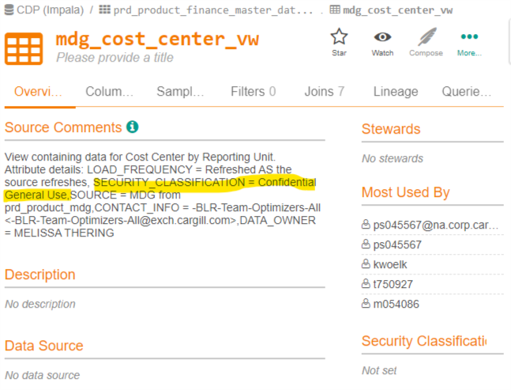
Checklist – Compliance - 13 – Data Security
Security measures are in place that reflect the security classification assigned to the data concept, this includes auditing, access controls, and risk mitigation
The dataset should comply with all TGRC Data First guidance
Notes:
Actual security measures can only be verified by the Data Architect/Data Lead involved.
https://sites.cargill.com/sites/TGRC2/Pages/ssol_data_first.aspx

Slide 30
Checklist – Compliance - 14 – Legal & Compliance
All measures are in place to ensure the dataset meets all legal and contractual requirements, including privacy, storage and consumption requirements
This mean contractual restrictions (e.g., confidentiality), data privacy restrictions, or licensing restrictions.
The commercial lawyer for the business involved should be consulted for the certified data sets. If there are multiple businesses, the lawyer for the business with the most data can coordinate with other practice areas.
Cargill’s Law Hub has the most up-to-date information in a searchable database to identify applicable legal resources to contact.
Notes:
https://cargillonline.sharepoint.com/sites/LawClients/SitePages/Our-People.aspx
We should limit the number of lawyers involved in these discussions. And if you get stuck, Elaine Olson can help navigate.

Slide 31
Checklist – Compliance - 15 – Data Retention
The entire lifecycle of the data in the dataset must be documented from creation to destruction
Data sourcing (#3) should document most of this, but need to include retention and purge requirements
The data owner should be aware of all retention requirements for the data concept associated with this dataset
Retention and purge requirements should be documented in DCP
and must be in alignment with any Records Information Management (RIM) retention policies;
RIM COE should be consulted for possible policy implications
and process must be in place to implement those policies
Purge processes should be documented with the architecture (#5) documentation
Notes:
New Alation template may be required to capture this information.
Data retention and purge processes can only be verified by the Data Architect/Data Lead involved.
Should there be a common purge process?
https://cargillonline.sharepoint.com/sites/RIMCOE

Slide 32
Checklist - Metadata
# | Checklist Item | Description
16 | Metadata is captured and available | Appropriate metadata about the dataset is properly documented and made available to all data consumers.
17 | Business rules defined and followed | The business and technical rules for how the data in the dataset is to be managed is documented, maintained, and published.
18 | Linked to Cargill’s Data Taxonomy | The dataset is associated with a data concept within Cargill’s Data Taxonomy and complies with all rules associated with that data concept.

Slide 33
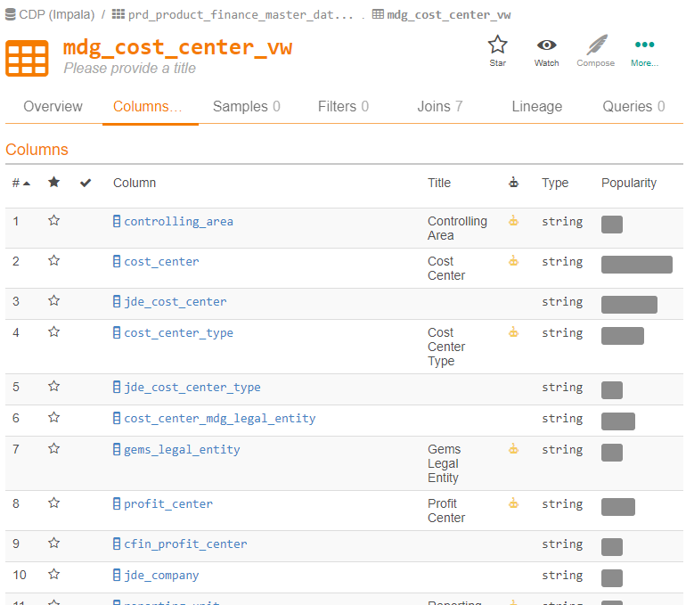
Checklist – Metadata - 16 – Metadata
Appropriate metadata about the dataset is properly documented and made available to all data consumers
Dataset metadata should be captured in DCP
DCP metadata minimums should be followed
Metadata should be consistent across value chain
Upstream data source metadata need not be in DCP (or metadata captured in source systems) but it should be understood, documented, and differences noted
Notes:
What minimal knowledge of upstream datasets should be documented? And where?
Should data modeling be required?
Data modeling tools can reverse engineer and forward engineer to provide consistency along the value chain.
https://datacatalog.cglcloud.com/article/121/metadata-minimums

Slide 34
Checklist – Metadata - 17 – Data Rules
The business and technical rules for how the data in the dataset is to be managed is documented, maintained, and published
Notes:
What is not already covered in #16 Metadata, #3 Data Sources, #5 Architecture, #7 Data Quality, #13 Security, #15 Retention?

Slide 35
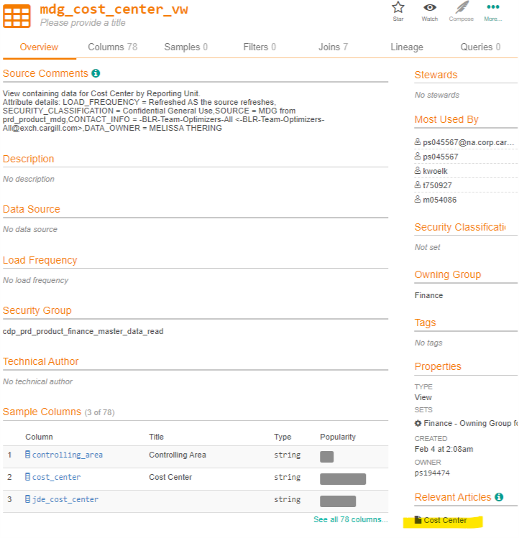
Checklist – Metadata - 18 – Data Taxonomy
The dataset is associated with a data concept within Cargill’s Data Taxonomy and complies with all rules associated with that data concept
Data Concept is define in DCP and approved by the Data Architecture COP
The dataset is linked to the data concept

Slide 36
Checklist – Development
# | Checklist Item | Description
19 | Complies with architecture and development standards | The dataset is constructed in accordance with applicable standards and best practices for the technology and platform on which it is built.

Slide 37
Checklist – Development - 19 – Development
The dataset is constructed in accordance with applicable standards and best practices for the technology and platform on which it is built
Notes:
Use of development standards can only be verified by the Data Architect/Data Lead involved.
Where are these platform specific standards specified?
https://architecture.cglcloud.com/domains/technology.html
Are there standards that apply across all platforms?
https://wiki.cglcloud.com/index.php/Architecture_Principles

Slide 38
Checklist – Deployment
# | Checklist Item | Description
20 | Potential value of the dataset is documented | The value of sharing the dataset across all of Cargill is known and well documented.
21 | Deployment Plan is defined | A plan is in place for deploying the dataset for use to all known consumers.
22 | Marketing Plan is in place | A plan is in place for communicating the existence of the dataset to all potential consumers.
23 | Service Level Agreement is documented | Service levels to be provided to data consumers are defined and well documented.

Slide 39
Checklist – Deployment - 20 – Value Assessment
The value of sharing the dataset across all of Cargill is known and well documented.
A statement to explain why a data consumer should choose to use this dataset as opposed to another dataset, or create their own dataset.

Slide 40
Checklist – Deployment - 21 – Deployment Plan
A plan is in place for deploying the dataset for use to all known consumers.
The deployment plan describes each step of the deployment process for each data consumer, the work steps for complete deployment, and who does them.
The plan includes information about system support, issue tracking, escalation processes, roles and responsibilities before, during, and after deployment.
The deployment plan is intended to provide both the data consumers and data providers with a smooth transition to the new dataset being deployed.

Slide 41
Checklist – Deployment - 22 – Marketing Plan
A plan is in place for communicating the existence of the dataset to all potential consumers
Develop a Brand Statement
Identify Your Unique Selling Proposition
Identify Your Business Objectives
Develop Audience / Customer Personas
Understand Other Key Publics, Too
Determine What the World Needs to Know About You
Choose Your Channels
Plan a Messaging Matrix
Determine Your Important Events and Campaigns
Set Your Communications Goals
Plan Content and Campaigns on Your Marketing Calendar
Measure Your Impact
Notes:
https://coschedule.com/blog/communications-plan-template/

Slide 42
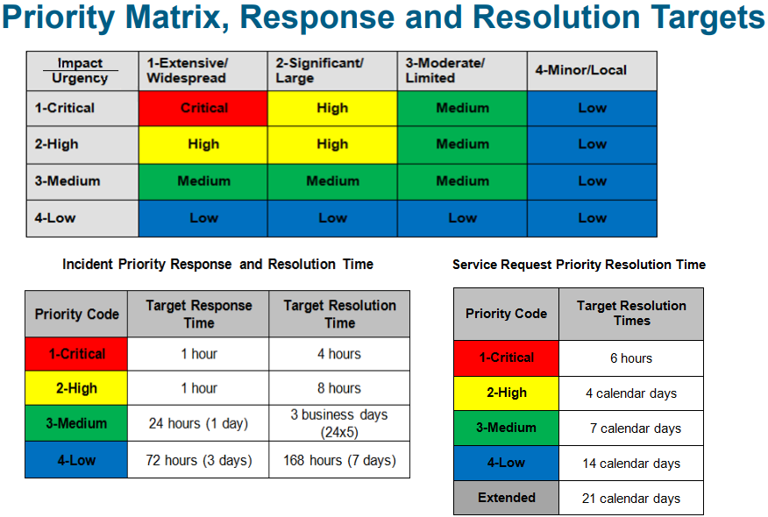
Checklist – Deployment - 23 – Service Level Agreement
Service levels to be provided to data consumers are defined and well documented
The Service Level Agreement (SLA) will typically have a technical definition for:
Mean Time Between Failures (MTBF):
Turn-Around Time (TAT): Time taken to complete a certain task.
Total Resolution Time (TRT): Total time taken to complete a certain task.
Mean Time To Recover (MTTR): Time taken to recover after an outage of service.
Notes:
SLA can only be lowest common denominator of all upstream data providers

Slide 43
Cross Enterprise Certified Dataset Process
Schedule review with DA COP
Presentation template
Review outcome documented in DCP
Reviewing a Cross-Enterprise Certified Dataset Once the dataset is complete and documented in DCP to the satisfaction of the Data Architect/Data Lead a notification should be send to Steve Sandberg (Principle Data Architect) to get the concept scheduled for review by the Data Architecture Community of Practice (DA COP). The Data Architect/Data Lead is expected to be present at the DA COP review to answer any questions that may arise. Once approved by the DA COP the status of the dataset will be set to “Certified“ in DCP.
Notes:
Proposed process taken from Data Taxonomy “How-To” article and modified for CDS.

Slide 44
Cross Enterprise Certified Dataset Extensions
Other area that choose to certify their own datasets that are not “cross-enterprise” may leverage this criteria and templates but the DA COP need not be involved.

Slide 45

Questions

